Slide 1
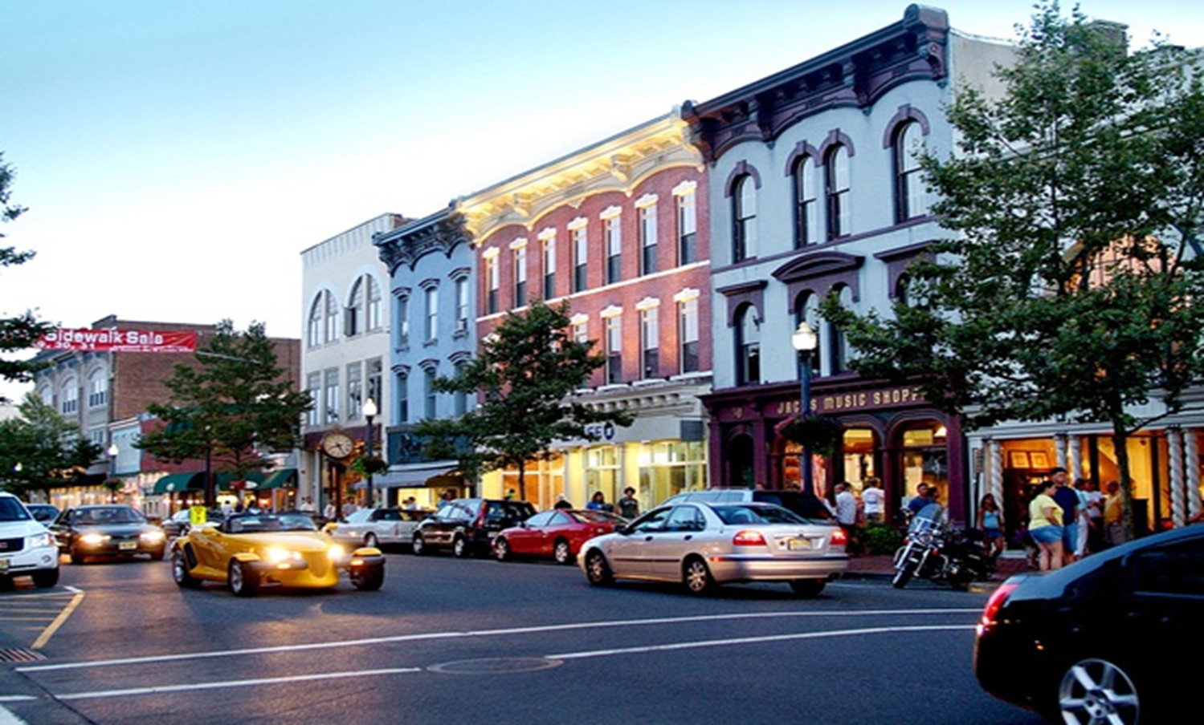
NJ Sustainable Business Registry
NJ Clean Energy Programs | September 19, 2019

Slide 2
Background on the Registry
NJ Sustainable Business Registry
{
Mission
Created to recognize and promote sustainable businesses across the state of New Jersey.
About
Launched in Fall of 2014 via a Partnership between the NJ Small Business Development Centers, the Environmental Protection Agency and the NJ Department of Environmental Protection.
{
{
Who can Join
The Registry is open to companies of all types and there is no cost to join
Notes:
NJSBDC is a network is committed to guiding established small business owners and aspiring entrepreneurs to create and expand their business enterprises which will, in turn, result in sustainable growth, job creation and statewide economic development and prosperity.
delivering management consulting and training programs to nascent entrepreneurs, start-ups and existing small businesses as well as specialized and more advanced services to high-impact, growth-oriented businesses
Have offices across the state, typically affiliated with universities

Slide 3
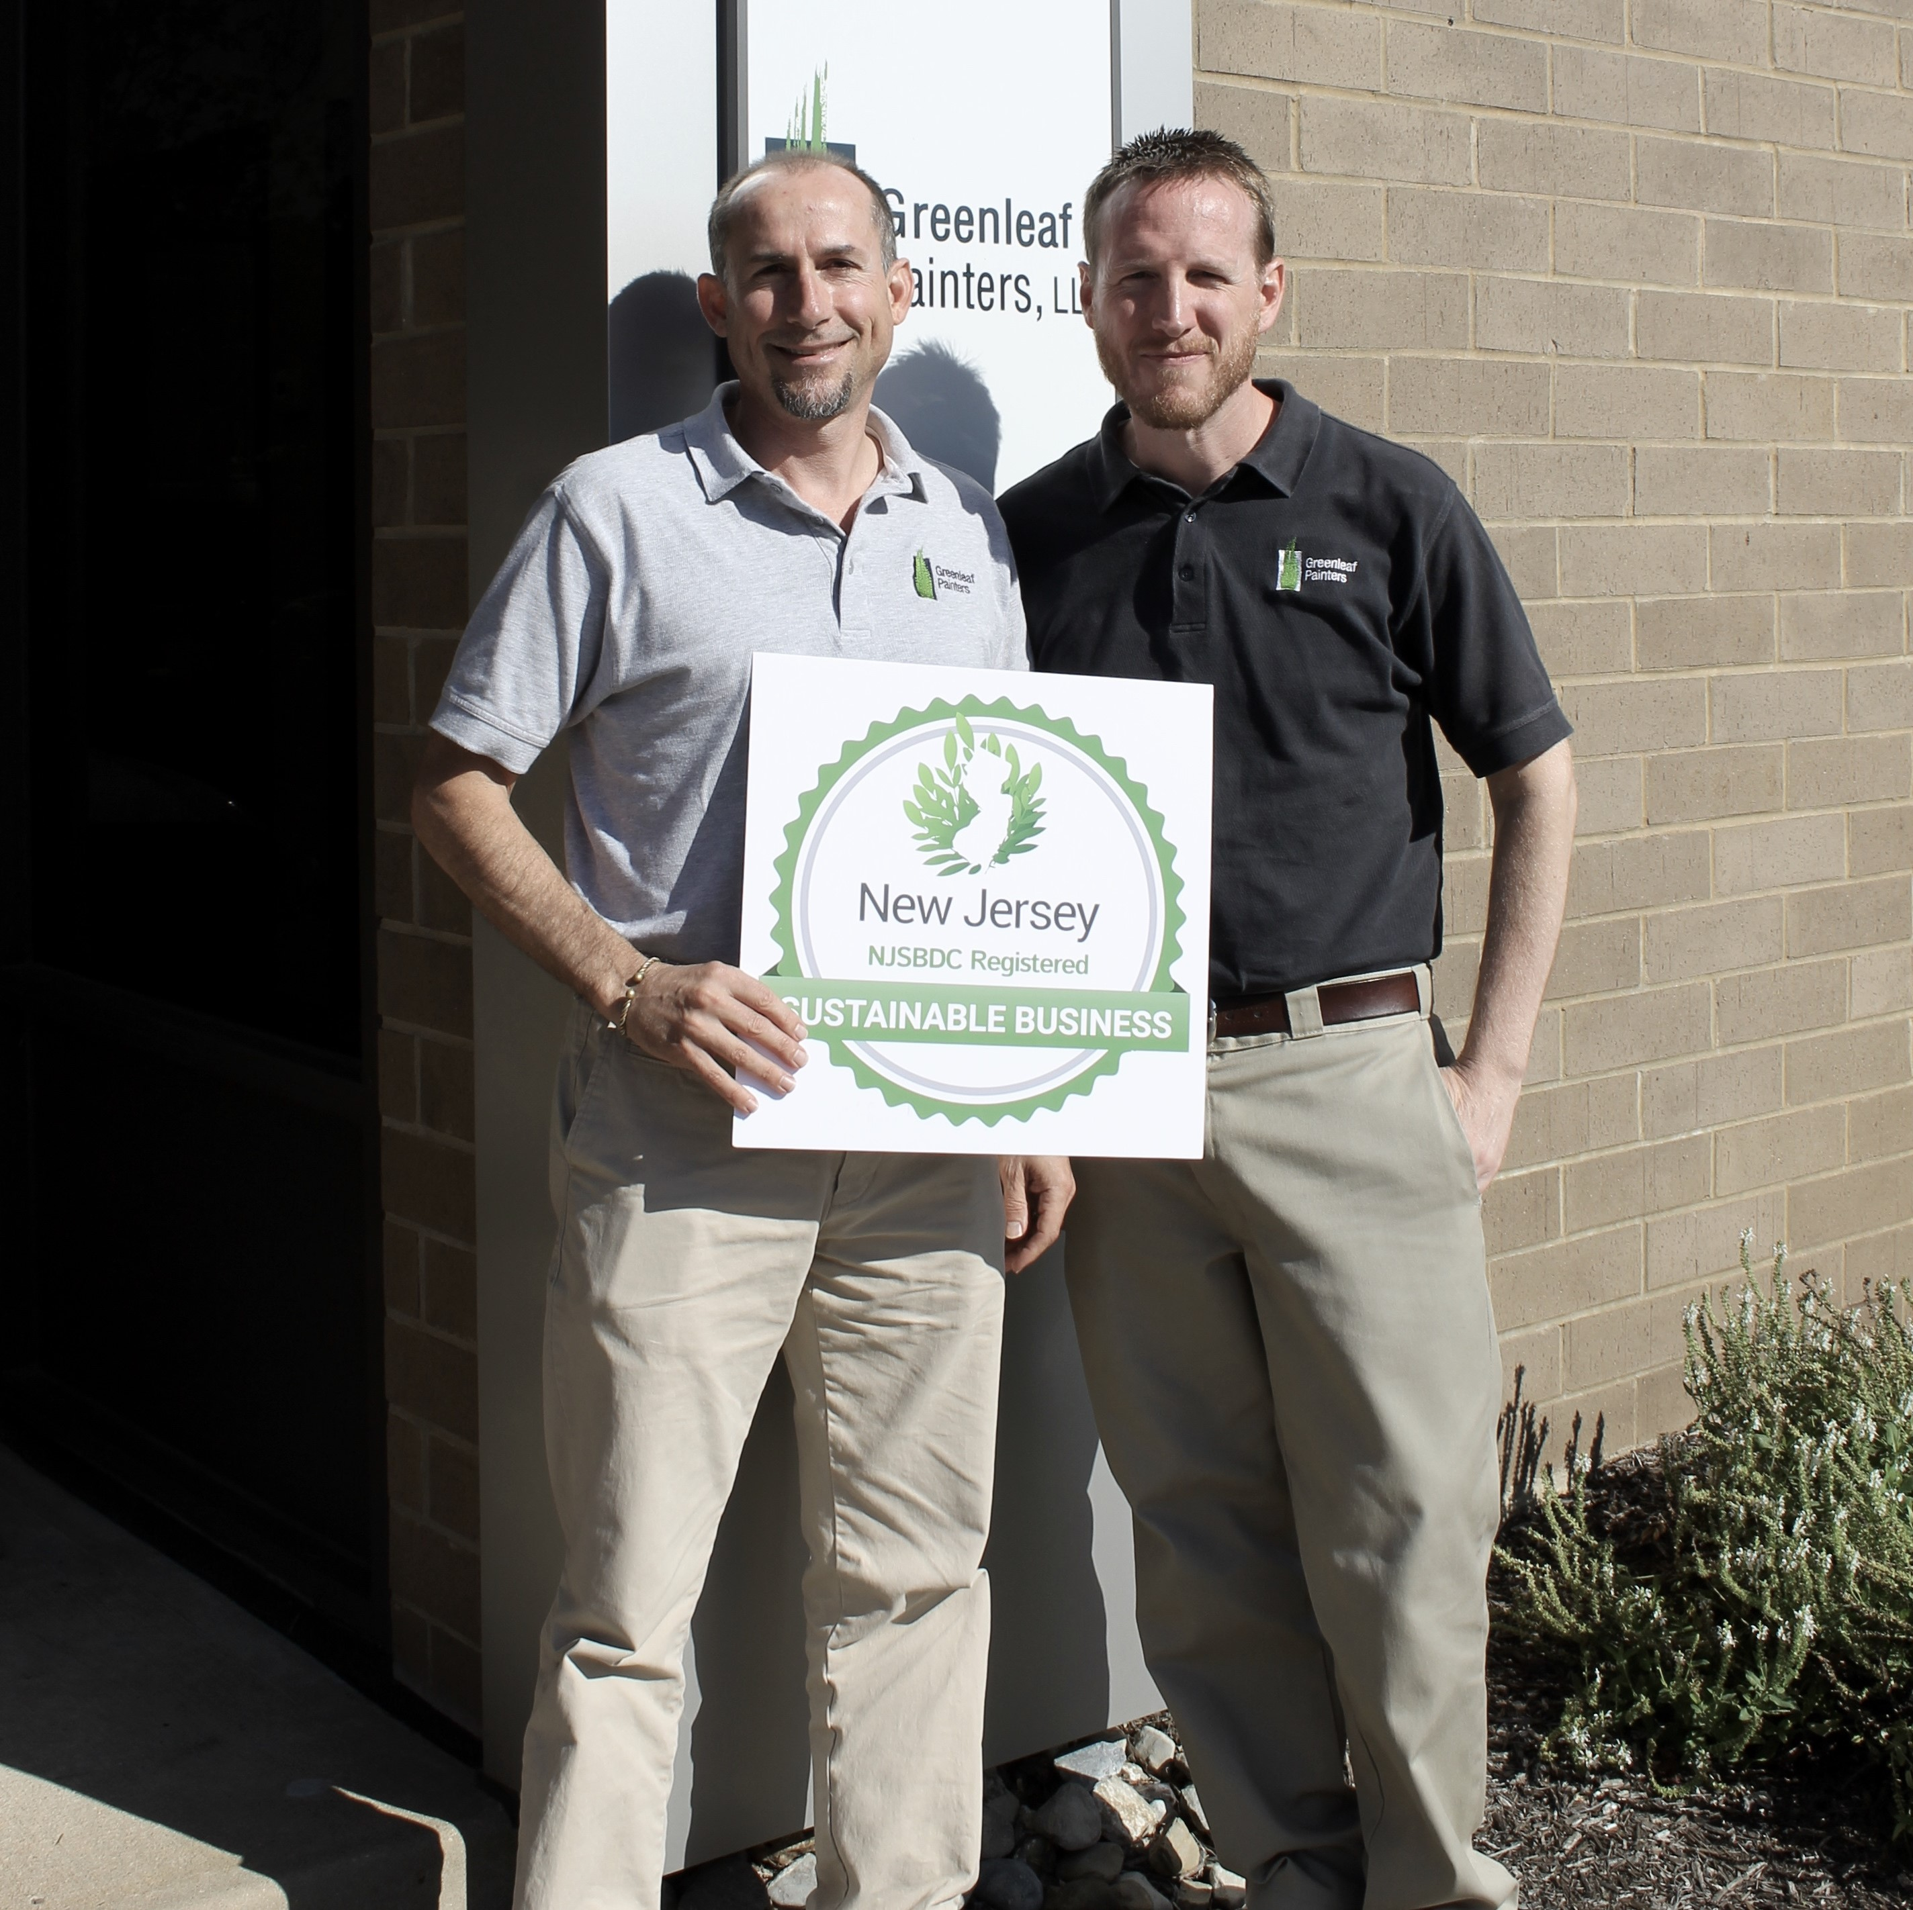
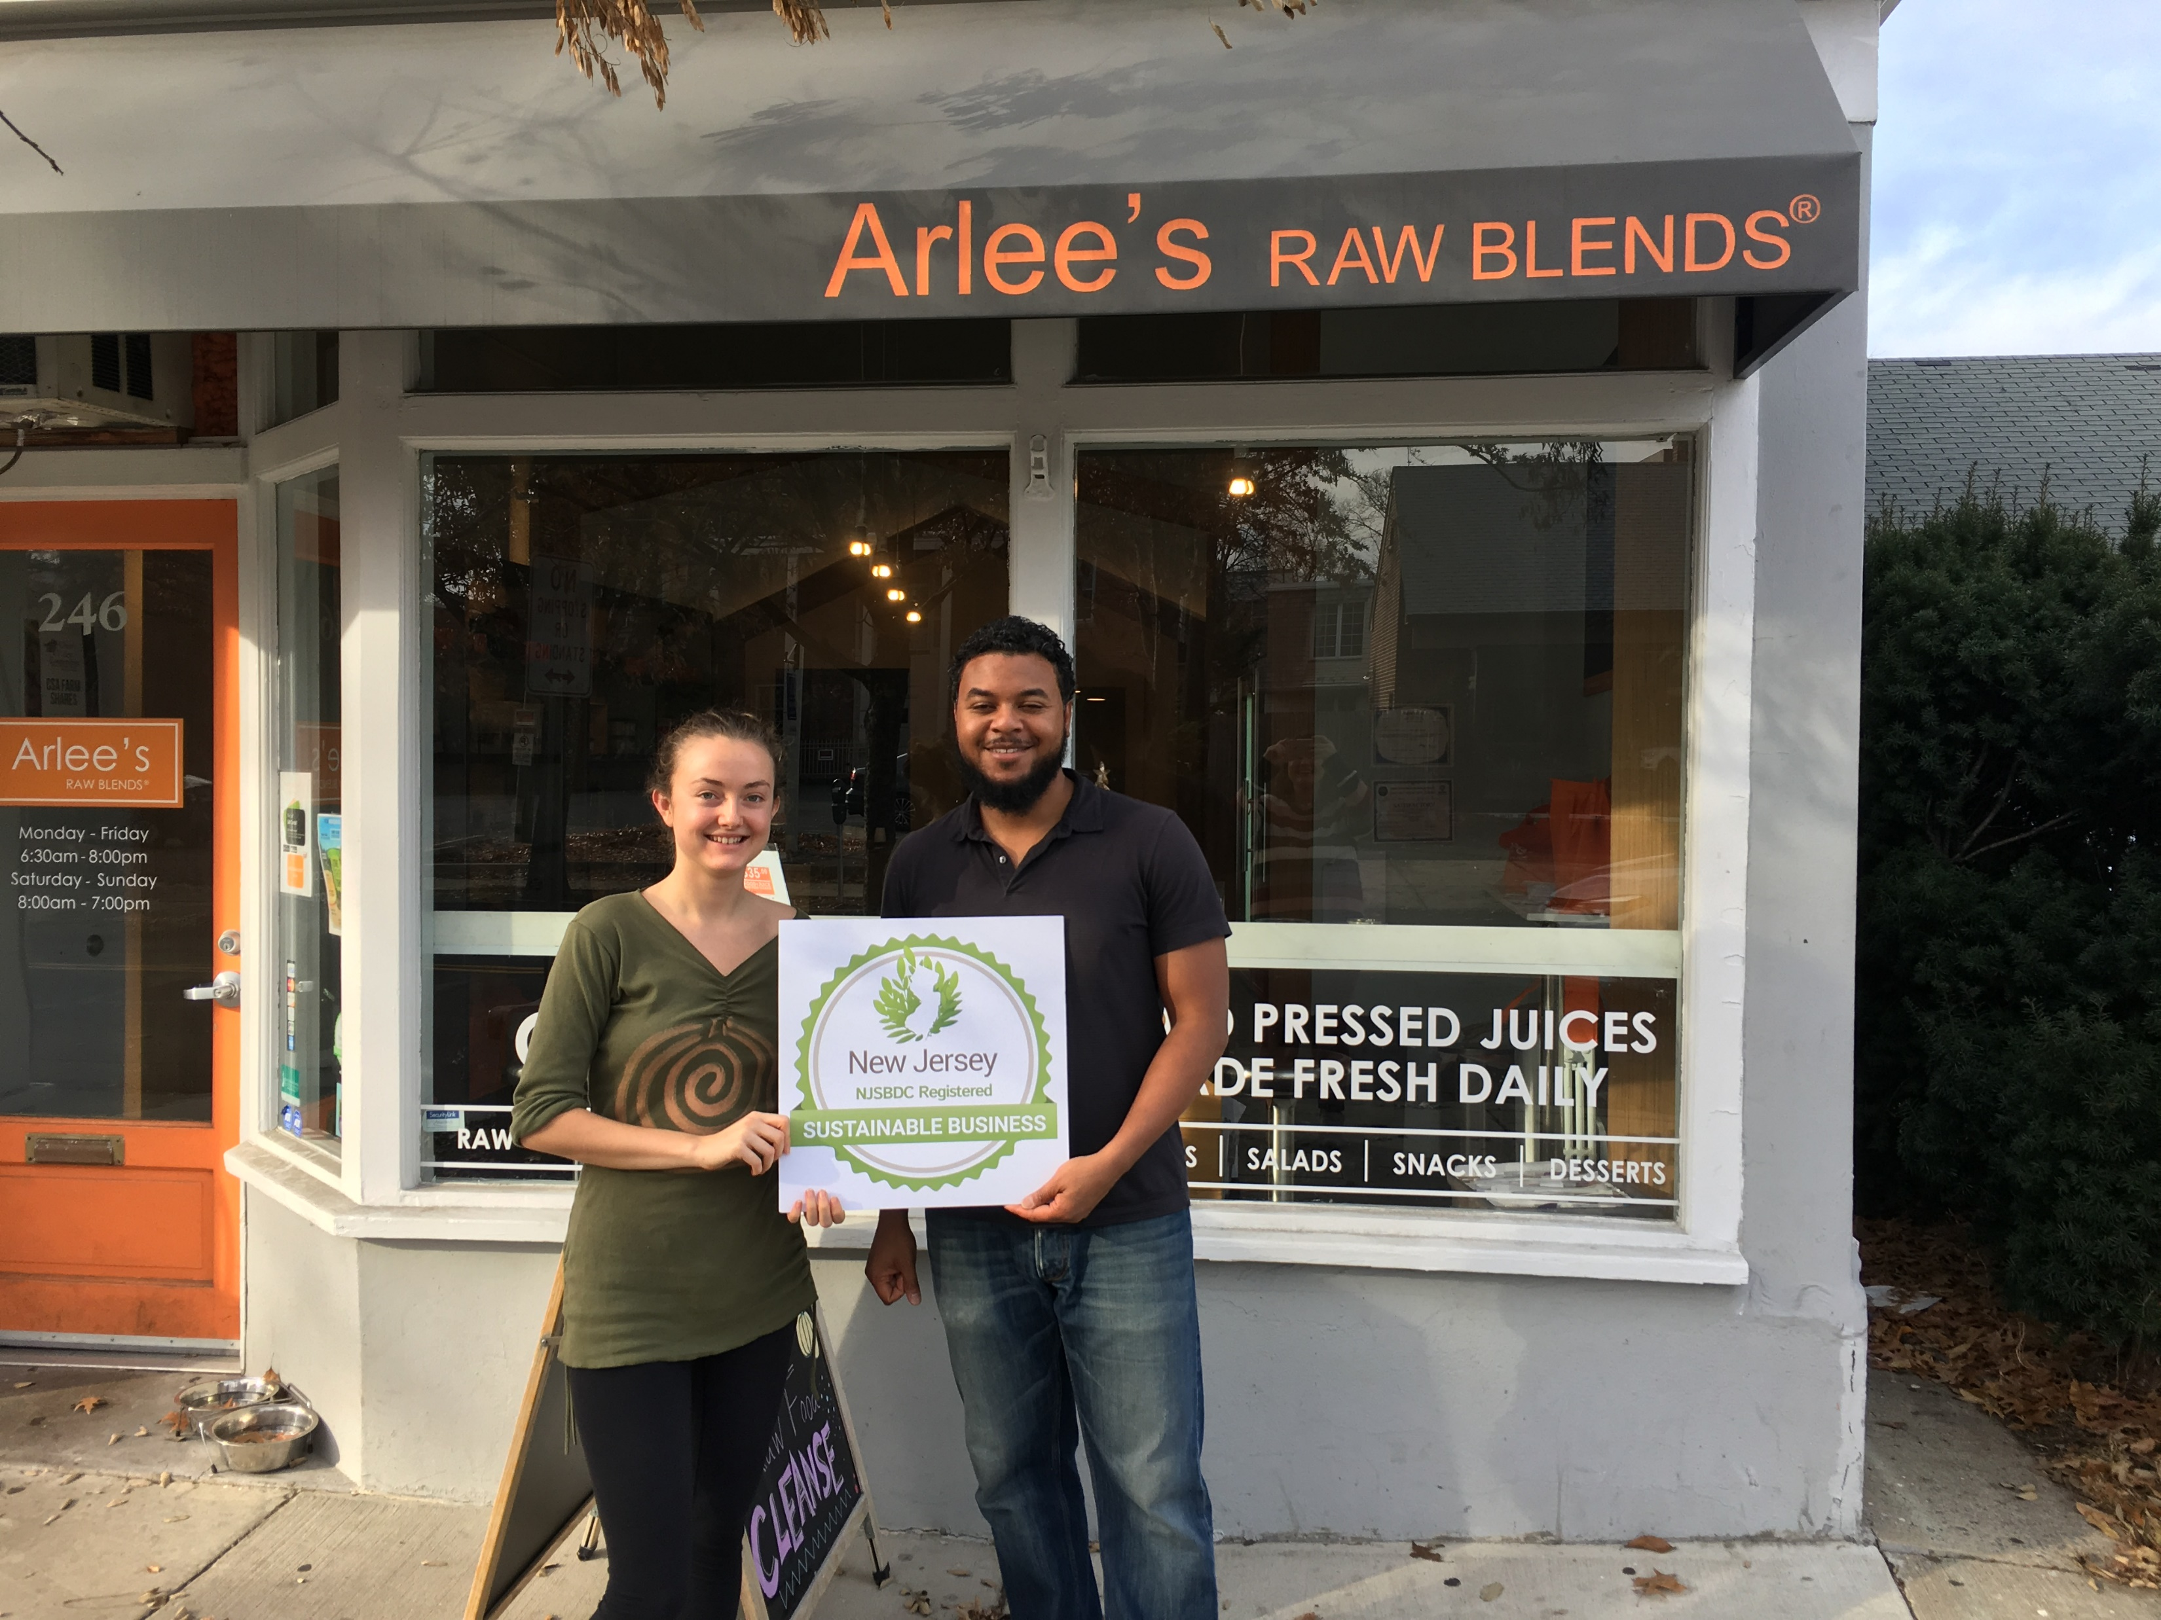
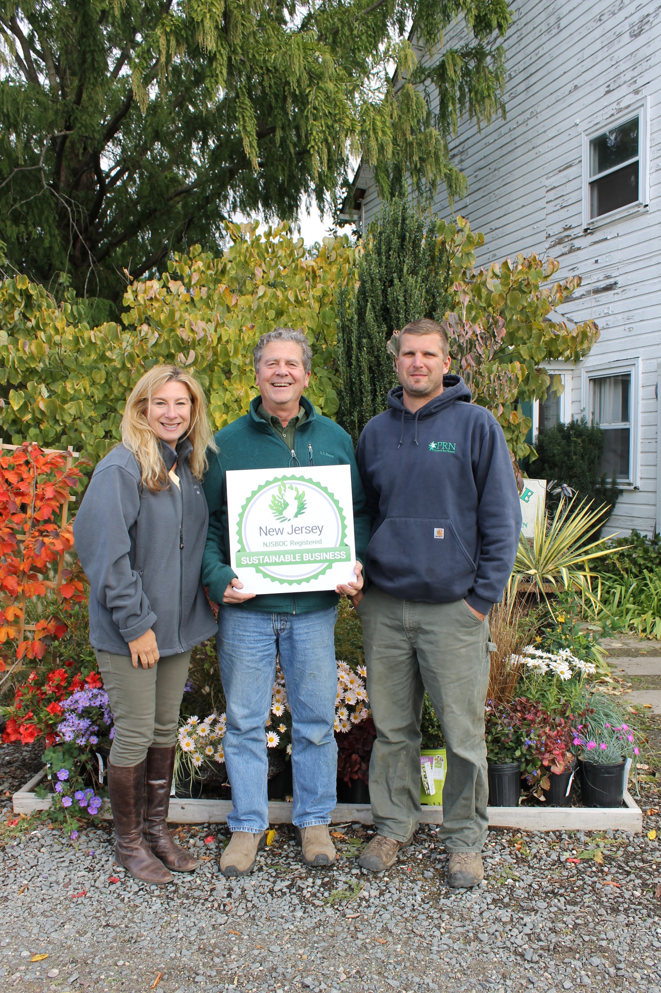
NJ Sustainable Business Registry
Background on the Registry
Business Registry Program to recognize and promote Sustainable Businesses in New Jersey
NJDEP Staff
Review and Approve Applications
Promote Registry across the state
Manage the Website, Social Media Accounts and Newsletter

Slide 4
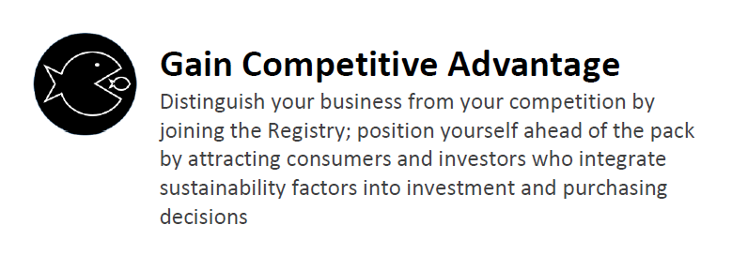
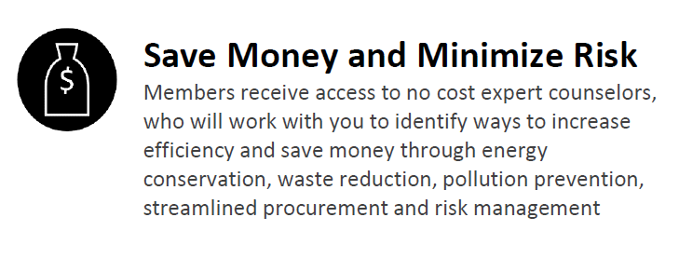
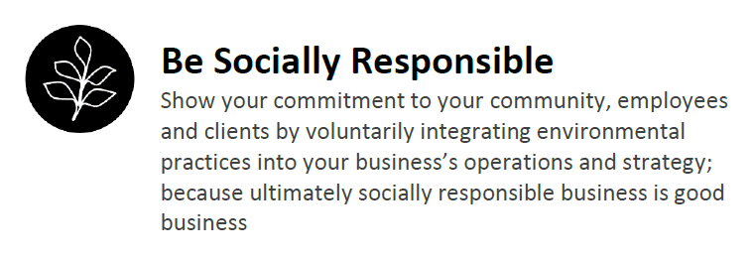
Membership Benefits
NJ Sustainable Business Registry

Slide 5
How to Sign Up
NJ Sustainable Business Registry
Create an online account: http://registry.njsbdc.com/
Submit a brief written description of Five Sustainable Actions/Practices your business, nonprofit organization or higher education institution has adopted
Identify One Measurable Environmental Benefit from a practice
Identify One Cost Savings from a Practice
Re-Register once every two years by showing continual improvement; Add One Sustainable Action/Practice at your Facility and One New Measurable Result

Slide 6
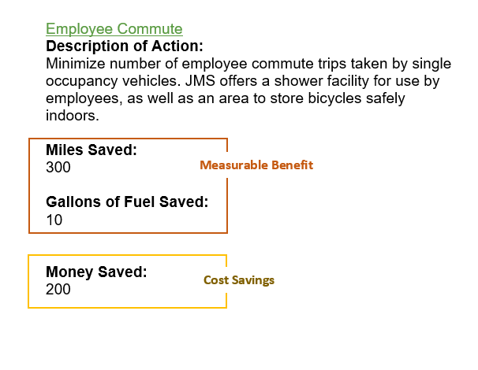
Application Requirements
NJ Sustainable Business Registry
Business must create a log in and report the following:
JM Sorge, INC
Five Sustainable Practices
One Measurable Benefit
Cost Savings from One Practice
1
2
3

Slide 7
Sustainable Business Guidelines
The Office of Sustainability developed Sustainable Business Guides to encourage New Jersey businesses to adopt sustainable practices and reduce their environmental impact. These guides are composed of simple actions you can take at work to help create a more sustainable New Jersey. The best practices are organized by topic area and by business sector and may include links to relevant external resources.
https://www.nj.gov/dep/aqes/sustain_bus.html
Notes:
Topics include: Green Building, Landscaping, Water, Waste, Energy, Transportation, Purchasing, Emergency Preparedness and Leadership
Sector Guides include: Restaurants, Medical Offices, Supermarkets, Breweries

Slide 8
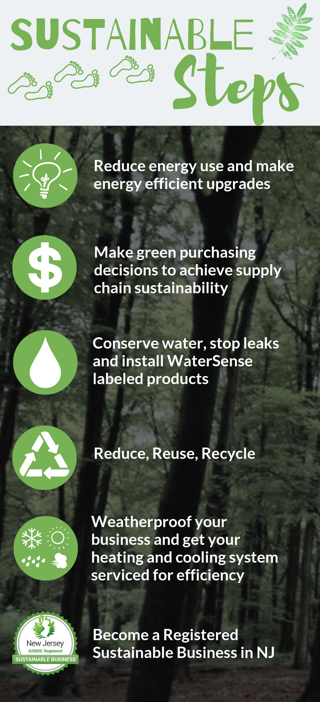
Take Action
Incentives are in place to help you!
Energy Benchmarking
SmartStart Buildings Program
Direct Install Program
http://njcleanenergy.com/
Notes:
New Jersey SmartStart Buildings can provide a range of support — at no cost to you — to yield substantial energy savings, both now and for the future.
Project Categories
Below are described the types of projects for which New Jersey SmartStart Buildings can offer support, at the time and pace required by each project event:
New Construction and Additions
Critical decisions affecting long-term energy use include building form and configuration, lighting, HVAC, and other systems. Integrating multiple energy-efficient options into a project design can result in synergistic savings much greater than savings achieved by simple substitution of stand-alone energy-efficiency measures. The easiest, most cost-effective way to achieve this synergistic benefit is to consider and select efficient alternatives during the design phase.
Renovations
Renovation projects typically entail a complete building overhaul, with major modifications to the shell as well as replacement of HVAC and lighting systems. Opportunities for equipment selection and design enhancements are similar to those for new construction projects and, likewise, are most effective when incorporated into the design phase.
Remodeling
Remodeling may be as simple as a change in lighting systems, or as complex as a totally new configuration of internal space with updated mechanical and/or electrical systems. Though not usually as extensive as renovations, remodeling projects may still offer considerable, cost-effective opportunities to improve energy efficiency.
Equipment Replacement
Three types of equipment replacement typically occur outside the scope of other construction events: (1) planned replacements, usually as part of scheduled maintenance; (2) on-demand replacement of failing or failed equipment; and (3) emergency replacement of failed essential equipment. Because equipment replacement decisions tend to be made quickly, New Jersey SmartStart Buildings is structured to allow very rapid response.
Benchmarking is a free service that assesses the energy performance of your facilities compared to similar buildings. Our program representatives will track and score your actual energy usage based on your industry type and provide a detailed report along with valuable information on implementing energy-efficient technologies, including available financial incentives to lower project costs.
Created specifically for existing small to medium-sized facilities, Direct Install pays up to 70% of the project cost for replacing lighting, HVAC and other outdated operational equipment with energy efficiency alternatives

Slide 9
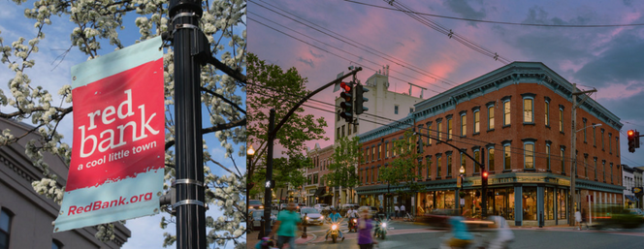
Sustainable Jersey Green Business Recognition Program
Sustainable Jersey Green Business Recognition Program
Establish a Green Business Recognition Program for local companies. A minimum two businesses must be participating in the Program.
10 Points
20 Points
Incorporate participation in the Registry as part of the criteria for your Green Business Recognition Program. A minimum three businesses must be participating.

Slide 10
Why Work with Local Businesses?
Relationship Building
Learning Opportunity
Gateway to Engagement
Establishes a relationship and creates a favorable impression within the business community
Gives local leaders the opportunity to learn the unique challenges for businesses in adopting sustainable practices
Lays the groundwork for more meaningful engagement and partnerships in the future
Notes:
savings can go a long way toward helping to create jobs and controlling property taxes for residents. Municipal and school officials who want to create a sustainable community should start with engaging local businesses

Slide 11
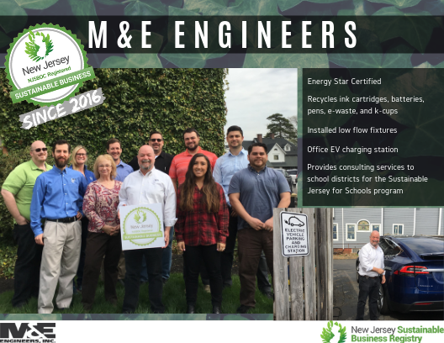

Slide 12
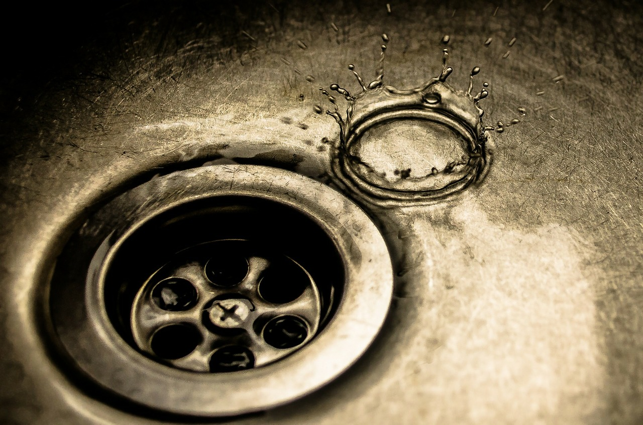
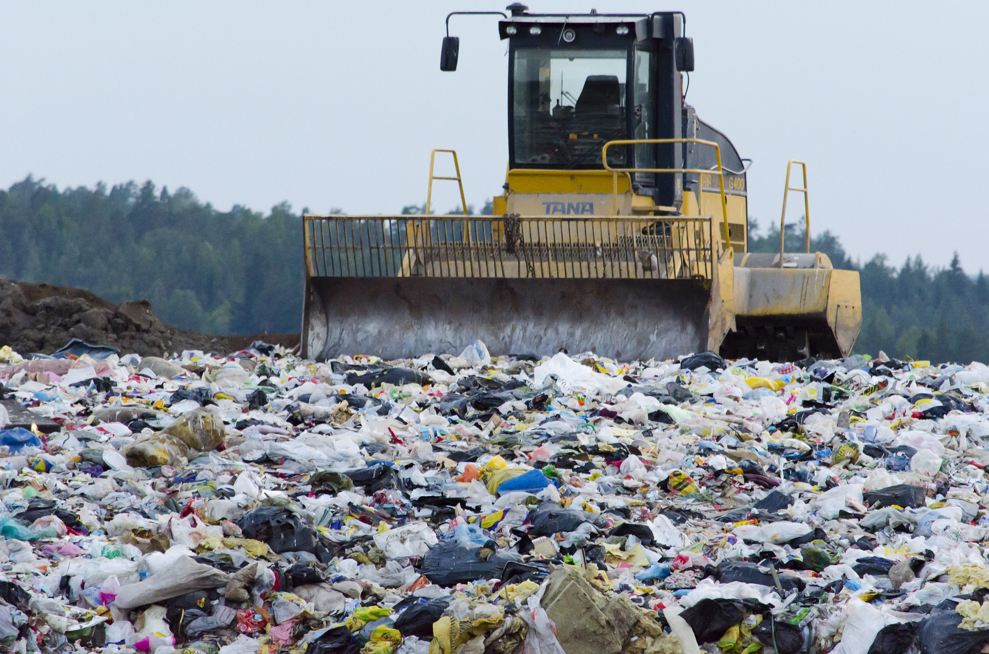
Annual Results
Members Make a Difference
17.2
83.4
4
million
million
million
kWh electricity saved
gallons of water conserved
vehicle miles reduced
400
8
19.5
thousand
million
million
gallons of fuel saved
dollars saved
pounds of waste reduced

Slide 13
CONTACT US:
Contact
Website
registry.njsbdc.com
Email Address
Gina.Gambacorto@dep.nj.gov
BE SOCIAL WITH US:
Like us on Facebook
@NJSustainableBusinessRegistry
Follow us on Twitter
@NJSBDC_GREENBIZ
Follow us on Instagram
@njsustainablebusinessregistry

