Slide 1
New Jersey’s
Clean Energy ProgramTM
Efficiency Opportunities for Commercial, Industrial, Institutional Buildings
September 19, 2019
Notes:
TITLE SLIDE OPTION A

Slide 2
New Jersey’s Clean Energy ProgramTM
C& I Programs Presentation
The Boathouse at Mercer County Lake
September 19, 2019
Notes:
TITLE SLIDE OPTION B

Slide 3
Agenda
Introduction to BPU and New Jersey’s Clean Energy Program
Program Highlights
Programs

Slide 4
NJCEP Background
Administered by
New Jersey Board of Public Utilities’ Office of Clean Energy
Funding
Societal Benefits Charge (SBC) on utility bill
Program Goals
Education
Change the public mindset
Provide opportunity for ALL NJ residents to
reduce energy and lower operating cost
Protect the environment and lower emissions
Meet Governor’s goal of 100% renewable by 2050

Slide 5
Programs to Meet Goals
CUSTOMER Education
ENERGY CONSERVATION
ENERGY EFFICIENCY
DISTRIBUTED ENERGY RESOURCES
Renewable energy

Slide 6
Program highlights
Notes:
We will go through how those programs performed in FY18

Slide 7
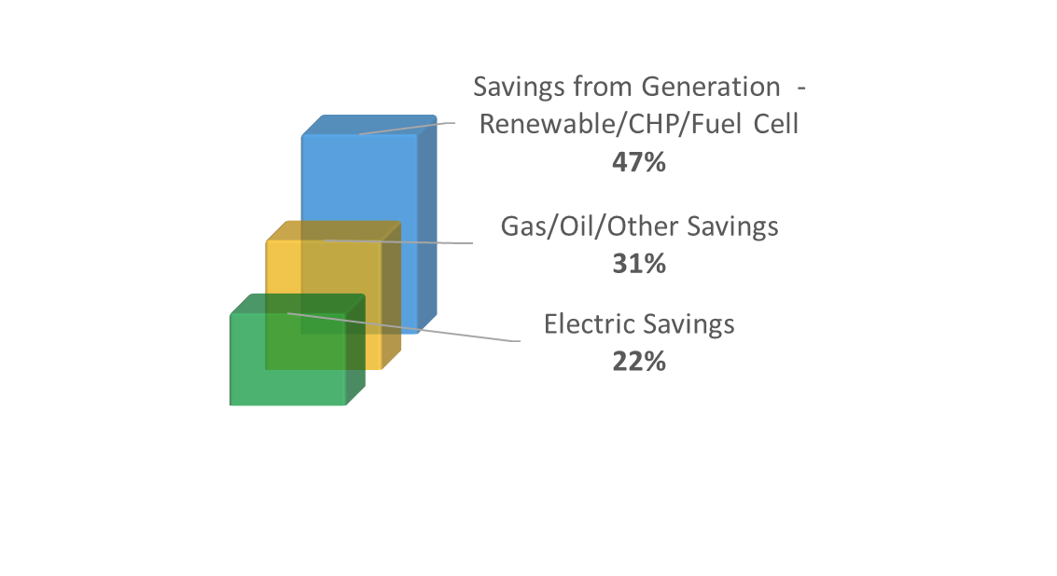
Program Performance…
FY18 data
8,000+ applications processed every month
Energy Savings are delivered through electric, gas, oil, other efficiencies and generation
$13,000,000+ incentives paid each month

Slide 8
…Brings Real-World Results
FY18 data
75,000+ cars removed
5,900,000+ trees planted
354,112 metric tons greenhouse gases eliminated
Notes:
Note
Stats are just FY18 performance of metric tons of CO2 eliminated.
Source
https://www.epa.gov/energy/greenhouse-gases-equivalencies-calculator-calculations-and-references
- 4.71 metric tons CO₂E/vehicle /year
- 0.060 metric ton CO₂ per urban tree planted (over 10 years)

Slide 9
More Information
Arif Welcher
Government/Business Manager
Office of Clean Energy
Arif.Welcher@bpu.nj.gov
609.292.0093
Visit
NJCleanEnergy.com
Newsletter
NJCleanEnergy.com/NEWSLETTER
ListservS
NJCleanEnergy.com/LISTSERVS
@NJCleanEnergy
Notes:
[use this slide or the previous slide]
BPU is welcome to use Outreach@NJCleanEnergy.com

Slide 10
NJCEP Portfolio of Programs
Renewable ENERGY
DISTRIBUTED ENERGY RESOURCES
SPECIALIZED ENERGY EFFICIENCY
COMMERCIAL & INDUSTRIAL
RESIDENTIAL
Offshore Wind
Community Solar
SREC Registration
Combined Heat & Power – Fuel Cells
Microgrid Development
Energy Storage*
Community Energy Grants
State Facility Initiatives
R&D Energy Tech Hub*
Workforce Development*
Energy Audits
Energy Efficiency Incentives
Multifamily*
High Performance Building Competition*
Trade Allies
New Construction
Existing Homes
Energy Efficiency Products
Trade Allies
* coming soon!

Slide 11
C&I Portfolio of Programs
Eligible Sectors: Commercial, Industrial, Government, Schools, Non-Profit, Institutional and Multifamily
Measurement & AUDITS
COMPREHENSIVE PROGRAMS
EQUIPMENT REBATES
DISTRIBUTED ENERGY RESOURCES
Energy Benchmarking
Local Government Energy Audits (for non-profits too)
Multifamily*
Single Measure
Multi-measure
Large Energy Users
Pay for Performance
Existing Buildings
New Construction
Direct Install
Customer Tailored Energy Efficiency Pilot
SmartStart
Existing Buildings
New Construction
Combined Heat & Power - Fuel Cells
* coming soon!

Slide 12
Benchmarking
Measurement & AUDITS
NJCleanEnergy.com/BENCHMARKING
WHO
Commercial, Industrial, Agricultural, Government, 501(c)(3) Non-Profit, and Institutional Entities
Cost
Free
WhY
Compare your building to other similar buildings nationally
Suggestions for improving operations and maintenance
Personalized incentive program eligibility and account manager follow-up support
ENERGY STAR® Portfolio Manager account setup and score

Slide 13
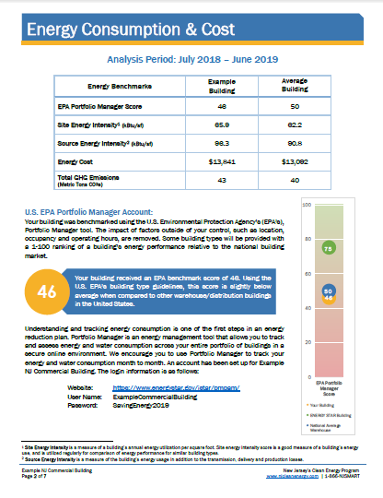
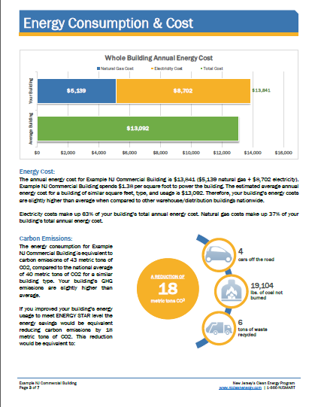
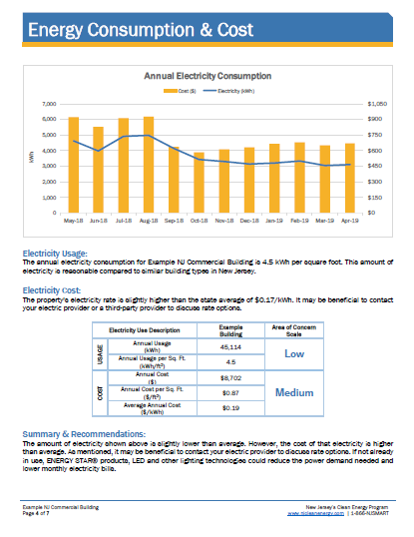
Benchmarking
Measurement & AUDITS
NJCleanEnergy.com/BENCHMARKING

Slide 14
Coming Soon!
Multifamily
Comprehensive
Programs
NJCleanEnergy.com/MULTIFAMILY
WHO
Multifamily owner, developer, management company, or homeowners association with five or more dwellings
where
In-unit, common area, and exterior area upgrades
ABOUT
A single point of entry for all eligible multifamily premises applying for incentives through the NJCEP portfolio
New construction and existing buildings
Flexibility to do a single-measure or multi-measure bundle
INCENTIVE CAP
Increased incentives and caps for UEZs, LMI and Municipalities

Slide 15
Coming Soon!
Multifamily
Comprehensive
Programs
NJCleanEnergy.com/MULTIFAMILY
Appliances
Lighting and Lighting Controls
Gas Water Heating
Gas Heating and Cooling
Electric HVAC and Chillers
Variable Frequency Drives
Simple, prescriptive incentives for most popular building technologies.

Slide 16
Pay for Performance
Comprehensive
Programs
NJCleanEnergy.com/P4P
WHO
Large C&I existing buildings or new construction seeking two or more energy efficiency measures with a minimum 15% savings
SIZE TO QUALIFY
Annual peak demand 200 kW+ in the previous year for existing buildings or over 50,000 square feet of planned new construction
ABOUT
A pre-approved Participating Partner will streamline the program and guide users through the program phases
INCENTIVeCAP
50% of project cost (or 80% for UEZ/OZ/ MUNI/K-12 Public Schools) up to $2M per project / $4M per entity annually
Incentive payments #2 and #3 are doubled for UEZ/OZ/ MUNI/K-12 Public Schools

Slide 17
Pay for Performance
Comprehensive
Programs
NJCleanEnergy.com/P4P
1 year
Program Enrollment
Submission and Approval of Application
Energy Reduction Plan (ERP)
Development and Approval
Installation of Measures
Installation Verification Report
Verification of Savings
Comparison of Performance vs ERP
Incentive #1
fixed
Incentive #2
up to 25%
project cost
Incentive #3
up to 25%
project cost
Notes:
2-3 years to complete the process (plan for 3 years)
Installation Verification Report:
NC: As-Built ERP
EB: Installation Report

Slide 18
Direct Install
Comprehensive
Programs
NJCleanEnergy.com/DI
WHO
Small to medium sized C&I existing facilities seeking to replace inefficient equipment
SIZE TO QUALIFY
Average annual peak demand <200 kW in the previous 12 months
ABOUT
A pre-approved regional Participating Contractor will do a walk-through evaluation and guide users through the program phases
Fast project turnaround time
INCENTIVE CAP
$125,000 incentive funding per project/building ($250K UEZ/OZ/ MUNI/K-12 Public Schools), or
$250,000 per entity ($500K ESIP; $4M UEZ/OZ/ MUNI/K-12 Public Schools)

Slide 19
Direct Install
Comprehensive
Programs
NJCleanEnergy.com/DI
Facilities in Urban Enterprise Zones (UEZ), Opportunity Zones (OZ), municipalities, and K-12 public schools:
INCENTIVE FUNDING
Up to 80% of installed cost is paid directly to the contractor
CUSTOMER
20% of installed cost
All other eligible facilities:
INCENTIVE FUNDING
Up to 70% of installed cost is paid directly to the contractor
CUSTOMER
30% of installed cost

Slide 20
Customer Tailored
Energy Efficiency Pilot
Comprehensive
Programs
NJCleanEnergy.com/CTEEP
WHO
C&I customers seeking a streamlined/single application for participants submitting for multiple different technology types
SIZE TO QUALIFY
N/A
ABOUT
On site assistance available
One application form for multiple prescriptive or custom measures
Utilizes SmartStart Incentives
Additional technical incentive available to offset soft costs associated with developing and planning custom projects
INCENTIVE CAP
Maximum incentive per entity is the lesser of:
$250,000 entity cap,
50% of eligible project costs, or
Buy-down to 1-year payback
Up to $10,000 for technical assistance of custom project evaluation
Same incentive values as SmartStart

Slide 21
Customer Tailored
Energy Efficiency Pilot
Comprehensive
Programs
NJCleanEnergy.com/CTEEP
Payment schedule based on program variation:
Energy Efficiency Plan Approval
Installation Complete
Performance Verification
Technical Assistance (Optional)
50%
50%
CTEEP Prescriptive Measures
100%
CTEEP Custom Measures
90%
10%

Slide 22
SmartStart
Equipment
rebates
NJCleanEnergy.com/SSB
WHO
All C&I: Commercial, Industrial, Agricultural, Government, Non-Profit and Institutional customers
SIZE TO QUALIFY
N/A
ABOUT
Individual high efficiency equipment rebates for new construction, renovation, remodeling, equipment replacement
Prescriptive and custom designed measures
Pre-approval required for lighting ≥ $100,000 and all custom measures
INCENTIVE CAP
Prescriptive: $500,000 for each electric or gas account
Custom, lesser of the following:
$0.16/kWh and/or $1.60/therm saved annually;
50% of incremental installed cost; and
Buy-down to 1 year payback based on incremental cost and savings

Slide 23
SmartStart
Equipment
rebates
NJCleanEnergy.com/SSB
Prescriptive Incentives
Custom Incentives
Lighting & Lighting Controls
Packaged HVAC
Boilers & Water Heaters
Chillers
VFDs
Food Service
Refrigeration
New or innovative technologies proven to be cost-effective and not listed as prescriptive
Projects must have a minimum first year energy savings of 75,000 kWh or 1,500 therms
Project pre and post inspection required
Existing buildings Prescriptive Only:
Double incentives for OZ/UEZ/ Muni/
K-12 Public schools

Slide 24
RESIDENTIAL PROGRAMS

Slide 25
Residential Portfolio of Programs
NJCleanEnergy.com/RESIDENTIAL
Home Performance w/ ENERGY STAR®
WARMAdvantage & COOLAdvantage
Energy Efficient Product Rebates
Residential New Construction
Comfort Partners
Whole-house and safety solutions for existing homes
Air sealing, insulation, heating and cooling upgrades
Up to a $4,000 rebate + 0% financing up to $10,000 or .99% up to $15,000
Stand-alone rebates for heating and cooling systems
Furnaces, boilers, water heaters, central air conditioners, mini-splits, heat pumps, etc.
Includes ENERGY STAR® certified refrigerators, dryers, washers, air purifiers, dehumidifiers, room air conditioners
Builders work with a rater to properly certify the homes to ENERGY STAR® certified or Zero Energy Ready Home levels
A FREE program including lighting upgrades, hot water conservation, replacement of fridges and thermostats, insulation upgrades and heating and cooling maintenance for income eligible families

Slide 26
More Information
Tony O’Donnell
Regional Outreach Account Manager
AODonnell@trccompanies.com
732.259.4938
Visit
NJCleanEnergy.com
Newsletter
NJCleanEnergy.com/NEWSLETTER
ListservS
NJCleanEnergy.com/LISTSERVS
@NJCleanEnergy
Notes:
[use this slide or the previous slide]
BPU is welcome to use Outreach@NJCleanEnergy.com

